Slide 1
Transforming waste management with Transfer learning

Slide 2
Abstract :
INTRODUCTION: Sorting a huge stream of waste accurately within a short period can be done with the support of digitalization, particularly Artificial Intelligence, instead of traditional methods. The overlap of Artificial Intelligence and Circular Economy can flourish many services in the environmental technology domain, in particular smart e-waste recycling, resulting in enabling circular smart cities.
OBJECTIVES: We analyse the growing need for automated e-waste recycling as an essential requirement to cope with the fast-growing e-waste stream and we shed the light on the impact of Artificial Intelligence in supporting the recycling process through smart classification of devices, where the smartphone is our case study.
METHODS: Our study applies transfer learning as a special technique of Artificial Intelligence by fine-tuning the output layers of AlexNet as a pre-trained model and perform the implementation on a small-size dataset that contains 12 classes from 6 smartphone brands.
RESULTS: We evaluate the performance of our model by tuning the learning rate, choosing the best optimizer, and augmenting the original dataset to avoid overfitting. We found that the optimizer of Stochastic Gradient Descent with Momentum and 3 𝑒𝑒⁻⁴ as a learning rate brings almost 98% model accuracy with generalization.
CONCLUSION: Our study supports automated e-waste recycling in decreasing the error-rate of e-waste sorting and investigates the advantages of applying transfer learning as the best scenario to overcome the rising challenges.

Slide 3
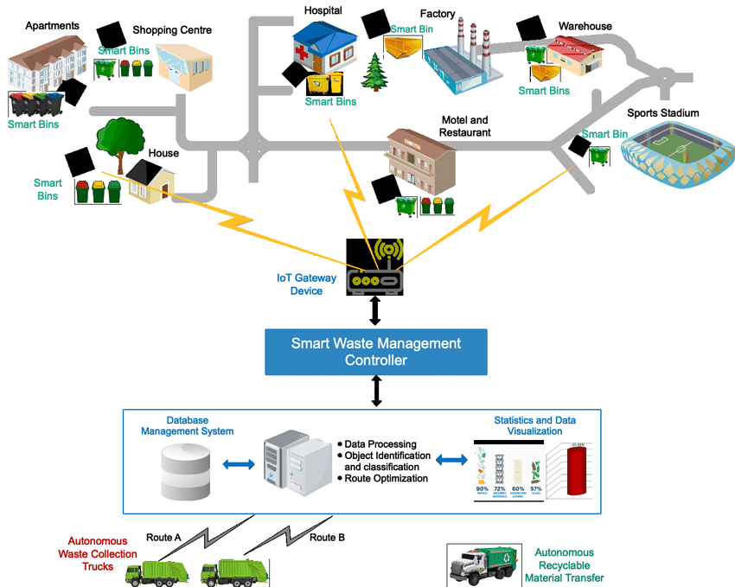
Architecture:
Transfer learning can significantly transform waste management by improving waste classification accuracy and efficiency using pre-trained deep learning models.

Slide 4
Waste Classification and Sorting:
Leveraging Pre-trained Models:
Deep learning models, like Convolutional Neural Networks (CNNs), are often trained on massive datasets for image recognition tasks. These models can be adapted for waste classification using transfer learning.
Reduced Data Requirements:
Instead of training a model from scratch on a new waste dataset, transfer learning allows you to fine-tune a pre-trained model, significantly reducing the amount of labeled training data needed.
Improved Accuracy:Transfer learning can lead to higher accuracy in waste classification compared to traditional machine learning methods, especially when dealing with complex waste streams.
Examples:Research papers have explored using transfer learning with models like ResNet, VGG-16, and YOLO for waste image classification.
2. Smart Waste Management Systems:
Automated Sorting:Transfer learning can be integrated into automated waste sorting systems, enabling faster and more efficient separation of recyclables from general waste.
Intelligent Waste Collection:
By combining transfer learning with IoT sensors and other technologies, smart waste management systems can optimize waste collection routes, reduce overflowing bins, and improve overall efficiency.

Slide 5
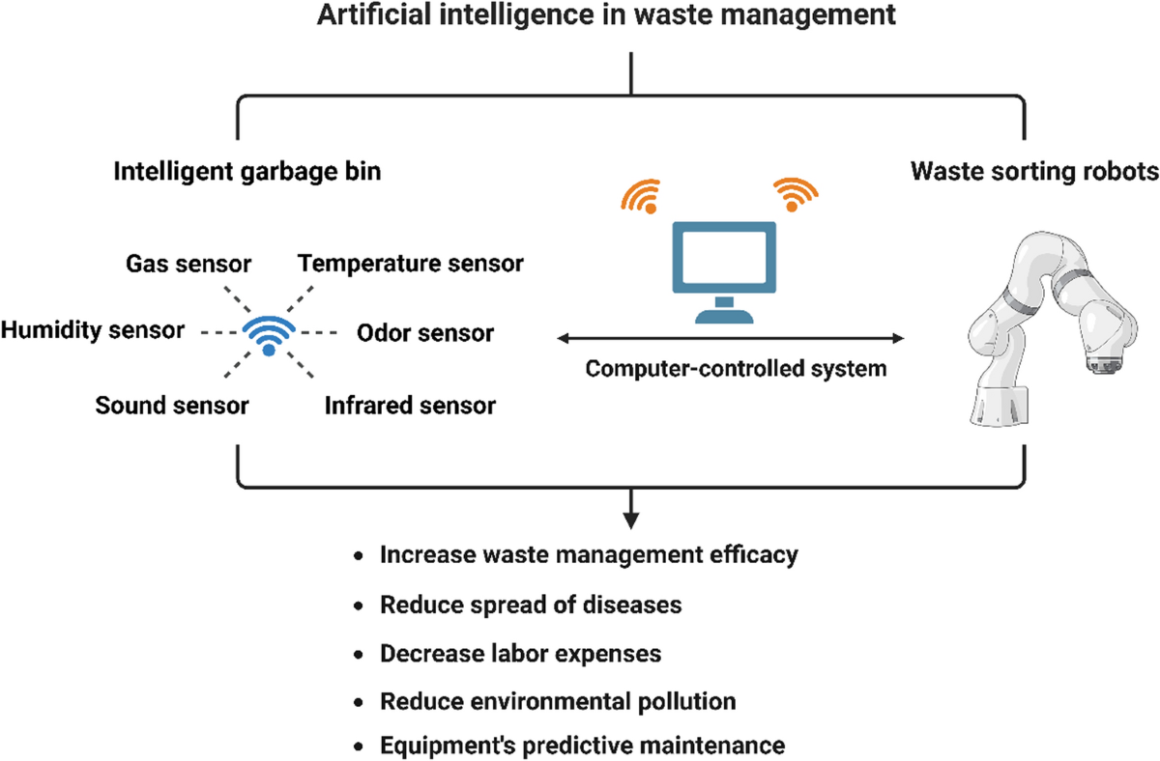

Slide 6
.
Method:
To put the previous concepts, namely AI, CE, and circular smart cities together in practice, we used the following technical aspects.
Deep learning usually requires being trained on a huge amount of data on neural networks. To design a CNN from scratch, the network architecture should be well-designed, including the number of layers, the number and specification of filters, besides tuning the training parameters like learning rate, optimizers, and activation functions. Next, this network should be trained for a relatively long time on a huge dataset. A promising alternative to designing from scratch is using the transfer learning technique [29]. Transfer learning uses previously learned knowledge from a source task and transfers them to the target task.

Slide 7
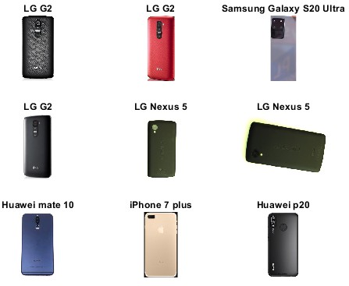
In the beginning, the network was initialized with frozen pre-trained weights for all layers except the last three layers, as described in previous work [8]. The learnable weights of AlexNet are frozen in the fully connected layer. To perform the fine-tuning, replacing this layer with a new fully connected layer has an output value equal to the number of classes in the new task.
Example of a subset of the dataset

Slide 8
Results and discussion
After setting the layers configuration and the training options, the model is ready for prediction. Evaluating the performance of the network is a challenging task and depends on the computational complexity. We performed three different experiments to choose the best parameters for our model with a baseline of data augmentation, optimizers, and learning rate.

Slide 9
Conclusion:
Transfer learning is effectively transforming waste management by enhancing waste classification accuracy and optimizing recycling processes. By leveraging pre-trained models on large datasets, transfer learning enables efficient waste sorting, reduces environmental impact, and promotes sustainable urban development. Research on the topic demonstrates that models like can achieve high classification accuracy, facilitating automated waste segregation. This leads to improved recycling rates and a more circular economy.

